Slide 1


Tank V/S Non-Tank
Model interpretation

Slide 2
Data Description
Electromagnetic Fields (EMF) Data:
Captures variation in magnetic field intensity during vehicle movement.
Types of EMF waves:
Absolute wave
Differential wave
Seismic Data:
Measures vibration amplitude and frequency patterns. Captures ground vibrations produced by moving vehicle.

Slide 3
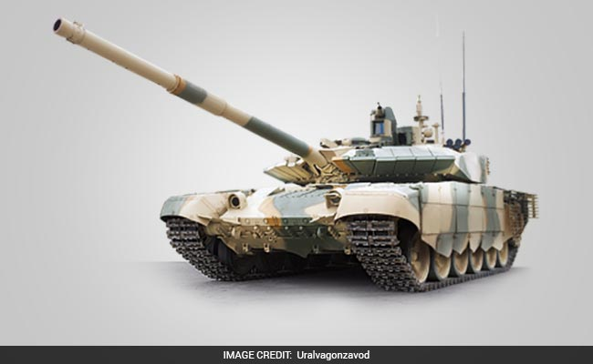
Data Preprocessing
For Each file we have calculated Mean, S.D, Maximum value, Minimum value, Signal energy, Peak count, Variance
6 features × 3 signals = 18 features we have used .
Instead of using raw Sensor data directly, we extract statistical feature from signal, also help in noise reduction

Slide 4
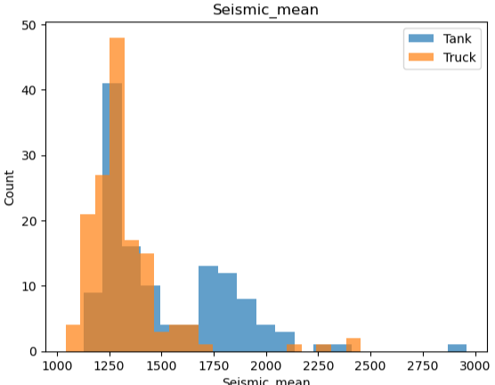
Data Visualization
Plot
Seismic energy
This Graph plot compares the seismic energy generated by tank and truck vehicles. We observe that tanks generally produce higher vibration energy, which helps the model distinguish between tank and non-tank vehicles.
From the visualization, tanks generally produce higher seismic energy, indicating stronger ground vibrations compared to trucks.

Slide 5
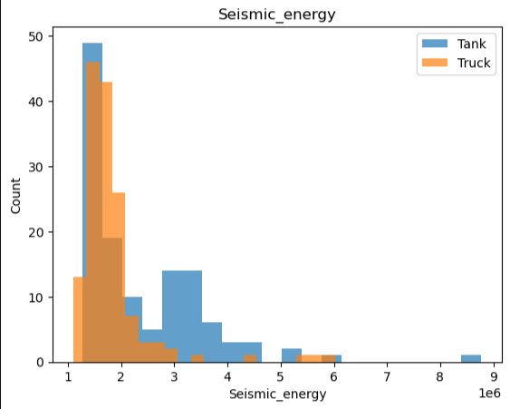
Data Visuals

Slide 6
Model Description
Model Used
A Random Forest Classifier was used for vehicle classification. Random Forest is an ensemble learning algorithm that combines multiple decision trees to improve prediction accuracy and reduce overfitting.
Features Used
Statistical features extracted from Absolute, Differential, and Seismic signals. Features include Mean, Standard Deviation, RMS, Energy, Peak-to-RMS ratio, and Kurtosis.
Training and Testing Dataset
The dataset was divided into training and testing sets.
80% of the data was used for training the model. 20% of the data was used for testing and evaluation.

Slide 7

Why Random Forest?
Handles complex patterns: It uses multiple decision trees, allowing the model to capture complex patterns and relationships that simpler linear models may miss.
Robust to noise: Since it combines multiple decision trees, it reduces the impact of noisy or irregular sensor signals.
Reduces overfitting: The ensemble approach improves generalization on unseen data.
Good classification accuracy: Provides reliable performance for binary classification problems like Tank vs Non-Tank detection.

Slide 8
Model Performance
Accuracy
The model achieved an overall accuracy of 87.27% on the test dataset. Which means it correctly classified 87 out of every 100 vehicle signals.
Confusion Matrix
Explanation:
26 Non-Tank vehicles were correctly classified as Non-Tank.
22 Tank vehicles were correctly classified as Tank.
4 Non-Tank vehicles were incorrectly classified as Tank.
3 Tank vehicles were incorrectly classified as Non-Tank.
Actual | Predicted Non-Tank | Predicted Tank
Non-Tank (class 0) | 26 | 4
Tank (class 1) | 3 | 22

Slide 9



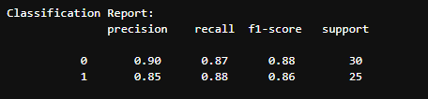
Model Performance precision, recall, and F1-score.
Precision
Precision measures how many predicted positive cases are actually correct.
High precision means fewer false alarms.
Recall
Recall measures how many actual positive cases
the model successfully detected.
High recall means fewer missed detections.
F1-Score
F1-score is the balance between precision and recall.
It gives a single score that considers both false positives and false negatives.
A higher F1-score indicates better overall classification performance.

Slide 10
Thank You

